Slide 1
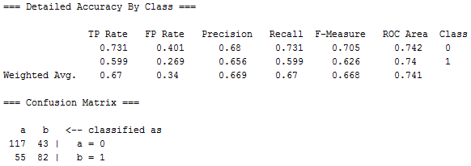
Sometimes fewer attributes is better
Weka’s Logistic Regression
a b
143 17 | a=0
29 108 | b=1
Weka’s Logistic with the same set of attributes
that gave the best result in Simple Logistic

Slide 2
Why Reduce Dimensionality?
Reduces time complexity: Less computation
Reduces space complexity: Less parameters
Simpler models are more robust on small datasets
More interpretable; simpler explanation
Data visualization (beyond 2 attributes, it gets complicated)
Lecture Notes for E Alpaydın 2010 Introduction to Machine Learning 2e © The MIT Press (V1.0)

Slide 3
Feature Selection vs Extraction
Feature selection: Chose k<d important features, ignore the remaining d – k
Data snooping
Genetic algorithm
Feature extraction: Project the original d attributes onto a new k<d dimensional feature space
Principal components analysis (PCA),
Linear discriminant analysis (LDA),
Factor analysis (FA)
Auto-association ANN

Slide 4
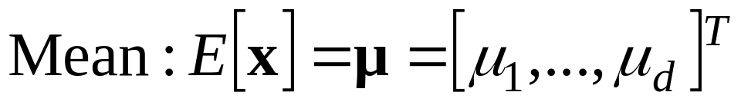
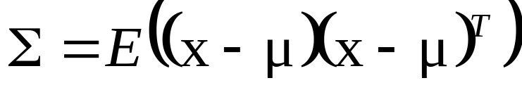
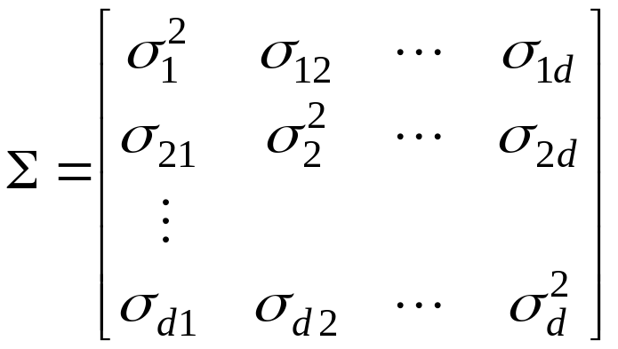
Principal Components Analysis (PCA)
Assume that attributes in dataset are drawn from a multivariate normal distribution. P(x)=N(μ, Σ)
Variance is a matrix
called “covariance”.
Diagonal elements are
σ² of individual attributes.
Off diagonals describe
how fluctuations
in one attribute affect
fluctuations in another.
dxd
dx1
1xd

Slide 5
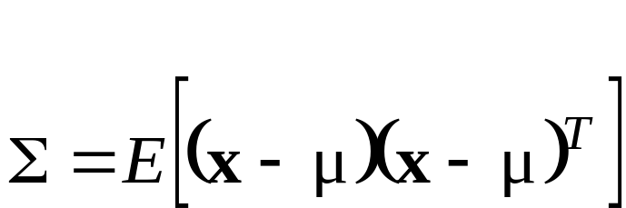

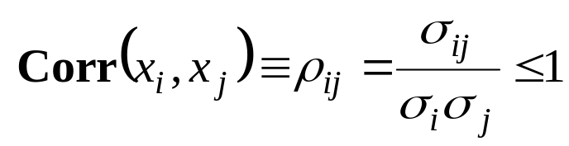
dxd
dx1
1xd
Dividing off-diagonal elements by the product of variances,
gives “correlation coefficients”
Correlation among attributes makes it difficult to say how
any one attribute contributes to an effect.

Slide 6
Consider a linear transformation of attributes z = Mx
where M is a dxd matrix. The d features z will also be
normally distributed (proof later).
A choice of M that results in a diagonal covariance matrix
in feature-space has the following advantages:
Interpretation of uncorrelated features is easier
Total variance of features is the sum of diagonal
elements

Slide 7
Diagonalization of the covariance matrix:
The transformation z = Mx that leads to a diagonal
feature-space covariance has M = W^{T} where the
columns of W are the eigenvectors of the covariance
matrix Σ.
The collection of eigenvalue equations Σw_{k} = λ_{k}w_{k}
can be written as ΣW = WD where D = diag(λ₁...λ_{d}) and
W is formed by column vectors [w₁ ... w_{d}].
W^{T}= W⁻¹ so W^{T}ΣW = W⁻¹WD = D
If we arrange the eigenvectors so that eigenvalues λ₁...λ_{d}
are in decreasing order of magnitude, then z_{i} = w_{i}^{T}x,
i = 1…k < d are the “principle components”

Slide 8
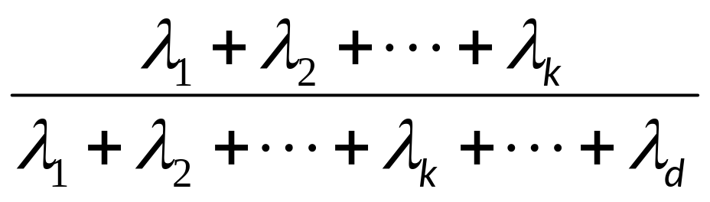
How many principal components ?
Proportion of Variance (PoV) explained by k principal components (λ_{i} sorted in descending order) is
A plot PoV vs k shows how many eigenvalues are
required in capture a given part of total variance

Slide 9
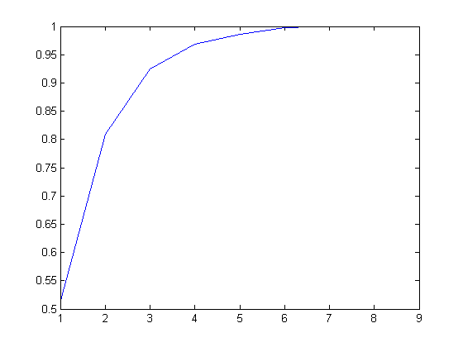
Example from last years homework assignment
PoV
Eigenvalue index

Slide 10
Proof that if attributes x are normally distributed with mean μ and covariance Σ, then z=w^{T}x is normally distributed with mean w^{T}μ and variance w^{T}Σw.
Var(z) = Var(w^{T}x) = E[(w^{T}x – w^{T}μ)²]
= E[(w^{T}x – w^{T}μ)(x^{T}w – μ^{T}w)]
= E[w^{T}(x – μ)(x – μ)^{T}w]
= w^{T} E[(x – μ)(x –μ)^{T}]w = w^{T} ∑ w
The objective of PCA is to maximize Var(z)=w^{T} ∑ w
Must be done subject to the constraint ||w₁|| = w₁^{T}w₁ = 1
Lecture Notes for E Alpaydın 2010 Introduction to Machine Learning 2e © The MIT Press (V1.0)

Slide 11
Application of Lagrange multipliers in PCA
Find w₁ such that w₁^{T}Σw₁ is maximum subject to constraint ||w₁|| = w₁^{T}w₁ = 1
Maximize L = w₁^{T}Σw₁ + c(w₁^{T}w₁ – 1)
gradient of L = 2Σw₁+ 2cw₁ = 0
Σw₁ = -cw₁
w₁ is an eigenvector of covariance matrix
let c = -λ₁
λ₁ is eigenvalue associate with w₁
Lecture Notes for E Alpaydın 2010 Introduction to Machine Learning 2e © The MIT Press (V1.0)

Slide 12
Prove that λ₁ is the variance of principal component 1
z₁ = w₁^{T}x
Σw₁ = λ₁ w₁
var(z₁) = w₁^{T}Σw₁ = λ₁ w₁^{T}w₁ = λ₁
To maximize var(z₁), chose λ₁ as largest eigenvalue
Definition of PC1
Eigenvalue equation of PC1

Slide 13
More principal components:
If Σ has 2 distinct eigenvalues, define 2nd principal component
by max Var(z₂), such that ||w₂||=1 and orthogonal to w₁
Introduce Lagrange multipliers α and β
Set gradient of L with respect to w₂ to zero
2Σw₂ – 2αw₂ – βw₁ = 0
Choose β = 0 and α = λ₂
get Σw₂ = λ₂w₂
To maximize Var(z₂) chose λ₂ as the second largest eigenvalue

Slide 14
Example: cancer diagnostics
Metabonomics data
94 samples
35 metabolites in each sample = d
60 control samples
34 diseased samples

Slide 15
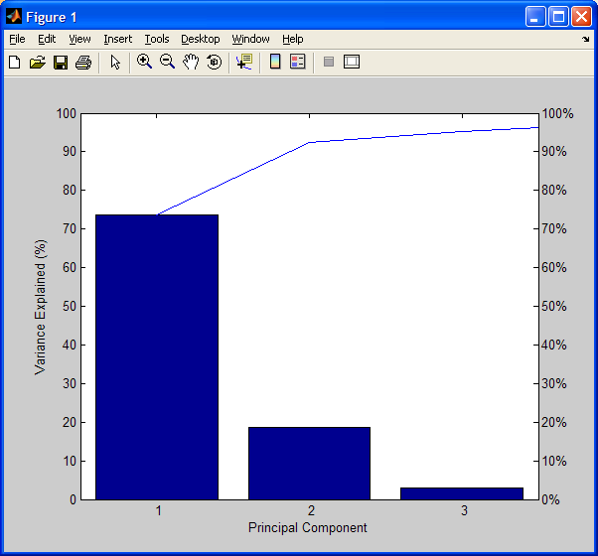
proportion of variance plot
ranked
eigenvalues
3 PCs capture > 95%
73.6809
18.7491
2.8856
1.9068
0.7278
0.5444
0.4238
0.3501
0.1631

Slide 16
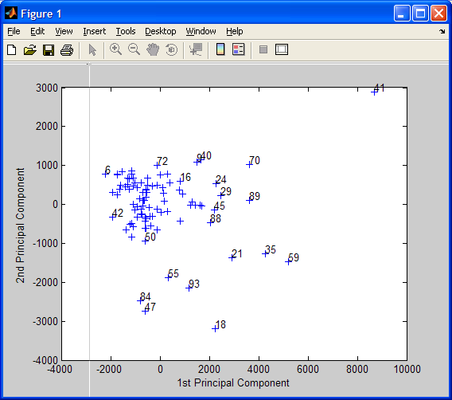
Scatter plot of
PCs 1 and 2
1-34 cancer
>35 control
Samples from
cancer patients
cluster

Slide 17
Use PCs to reduce dimensionality of beer-bottle classification
d=9 in attribute space
Find the eigenvalues and eigenvectors of the covariance matrix for data set randomized shortened glassdata.csv.
Plot the PoV. How many eigenvalues are required to capture more than the 90% of the variance?
Transform the attribute data by the eigenvectors of the 3 largest eigenvalues. How are these features defined?
Use a validation set of 100 examples to find the best quadratic extension of a linear model by successively including z₁², z₂², z₃², z₁z₂, z₁z₃, and z₂z₃. Plot E_{val} vs number of added terms and identify the elbow.
Use all data to compare the best quadratic extension with the linear model in attribute space (confusion matrix and fraction correctly classified).

Slide 18
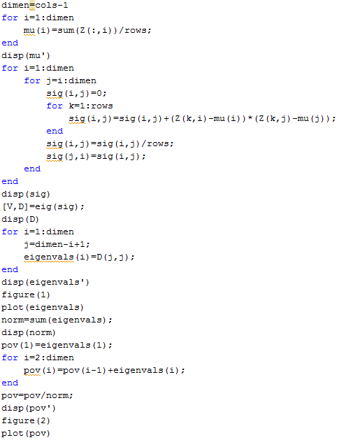
PCA code for glass data

Slide 19
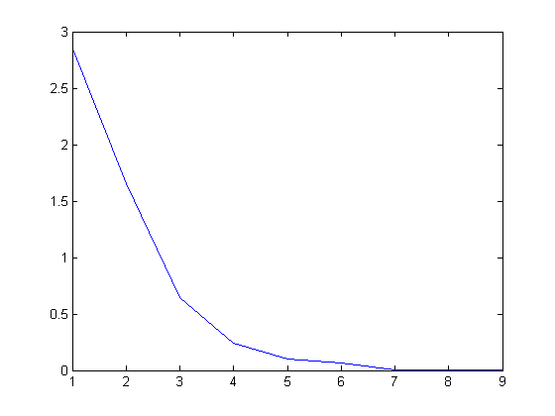
eigenvalues
indexed by decreasing magnitude

Slide 20
PoV
indexed by decreasing magnitude

Slide 21
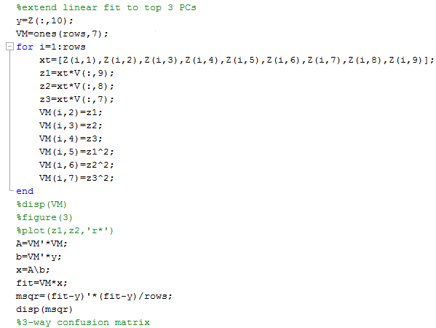
Extend MLR with PCA features

Slide 22
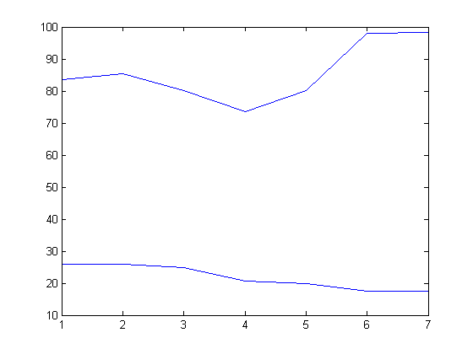
E_{val} suggests best model is L+x₁²+x₂²+x₁³
Unfortunately not much better than L when full dataset is used.
L +x₁² +x₂² +x₁³ +x₁x₂ +x₁x₃ +x₂x₃

Slide 24
Review
For any dxd matrix M, z=M^{T}x is a linear transformation of attributes x that defines features z
If attributes x are normally distributed with mean μ and covariance Σ, then z is normally distributed with mean M^{T}μ and covariance M^{T}ΣM. (proof slide 8)
If M = W, a matrix with columns that are the normalized eigenvectors of Σ, then the covariance of z is diagonal with elements equal to the eigenvalues of Σ (proof slide 6)
Arrange the eigenvalues in decreasing order of magnitude and find λ₁...λ_{k} that accounts for most (e.g. 90%) of the total variance, then z_{i} = w_{i}^{T}x, i=1…k are the “principle components”
Lecture Notes for E Alpaydın 2010 Introduction to Machine Learning 2e © The MIT Press (V1.0)

Slide 25
More review
MatLab’s [V,D] = eig(A) returns both eigenvectors (columns of V) and eigenvalues D in increasing order.
Invert the order and construct
Chose k that captures the desired amount of total variance

Slide 26
How many eigenvalues does Σ have?
The “characteristic polynomial” of Σ can be used to address this question

Slide 27
Characteristic polynomial:
if Σw = λw, then (Σ - λI)w = o, where I is the identity
matrix
(Σ - λI)w = o has a nonzero solution iff (Σ - λI)
is singular
the eigenvalues of Σ are the values of λ such that
det(Σ - λI)=0
p(λ) = det(Σ - λI) is the “characteristic polynomial” of
matrix Σ

Slide 28
Characteristic polynomial continued:
If Σ is dxd then p(λ) has degree d
By Fundamental Theorem of Algebra, p(λ) has exactly d roots (counting multiplicities)
The roots of p(λ) are the eigenvalues of Σ
a dxd matrix has d eigenvalues but they may not be distinct
A real matrix may have complex eigenvalues, which occur in conjugate pairs (a + i b)
Eigenvalues of a real symmetric matrix, like Σ, are real

Slide 29
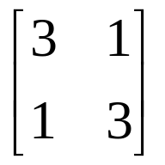
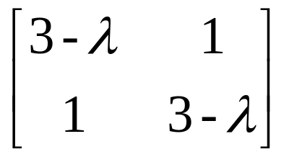
Example:
calculate eigenvalues of
det(A - λI) = det( )
(3-λ)(3-λ) –1 = λ² – 6λ +8 = 0
by quadratic formula λ₁ = 4 and λ₂ = 2
Not a practical way to calculate eigenvalues
of Σ

Slide 30
Possible questions and calculations about PCA
0. What is the fundamental assumption of PCA
Calculate eigenvalues of a 2x2 matrix by characteristic polynomial
Definitions of mean and covariance matrix in attribute space
Structure of covariance matrix in terms of variances and correlation coefficients of attributes
z=w^{T}x is a feature defined by projection of attributes in the direction of unit vector w. What is the variance of z in terms of the covariance of attributes?
Feature z_{k} is defined by the solution of Σw_{k} = λ_{k} w_{k} Show that λ_{k} is the variance of z_{k}
Define the proportion of variance captured by k-largest eigenvalues of the covariance matrix. Calculate PoV for given eigenvalues.
Eigenvectors define a transformation of the covariance matrix to a feature space where it is diagonal. What does this imply about fluctuations in principle components

Slide 31
Principal components defined by an auto-association ANN

Slide 32
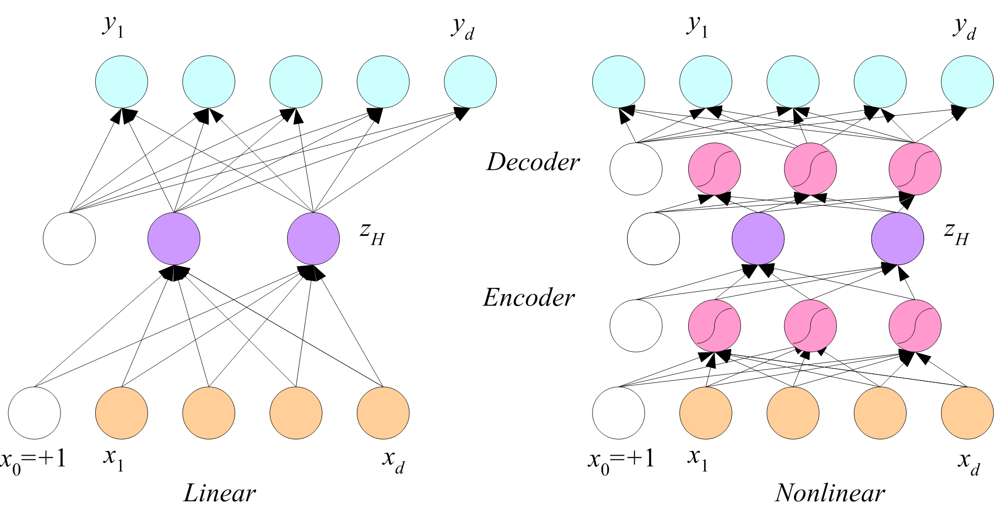
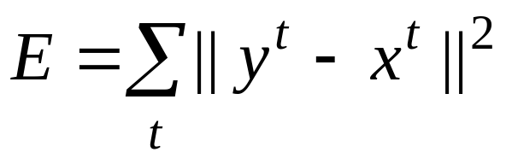
Application of auto-association networks for data smoothing
Non zero reconstruction error
can be the difference between
raw and smoothed data

Slide 33
Application of auto-association networks for data smoothing
and pattern recognition
In addition to eliminating noise, the principal components z_{H}
can be useful for data interpretation.

Slide 34
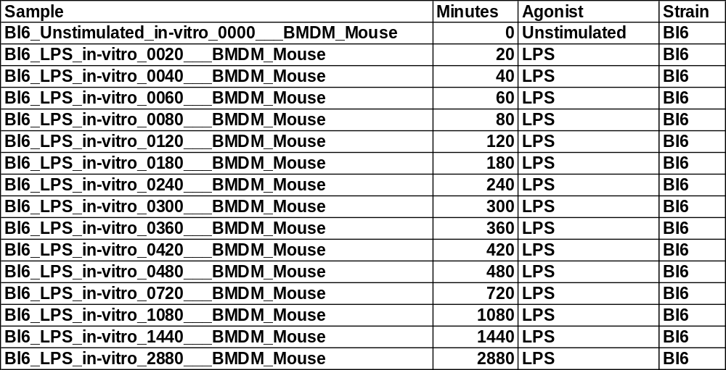
Application to gene expression data
Expression of 21,509 genes in B16 mice was measured for 2880 min after treatment with LPS, an agonist that induces inflammation.
Source: http://www.innateimmunity-systemsbiology.org

Slide 35
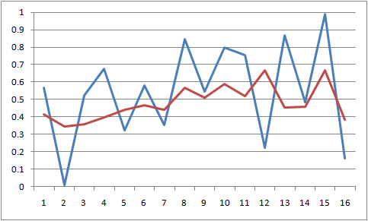
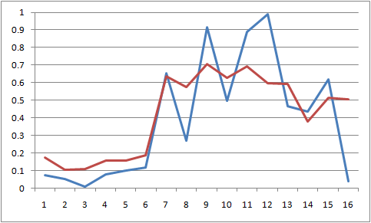
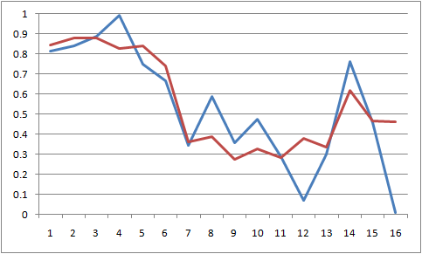
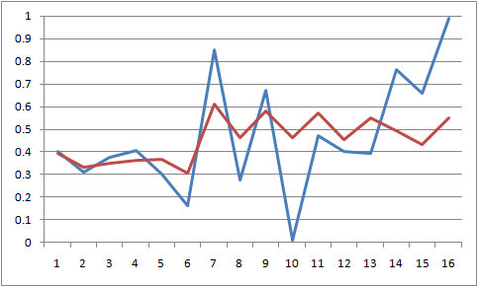
Non-linear PCA Smoothing
Input: expression level at 16 time points
Network: non-linear PCA (2 components).
Variance before smoothing: 0.08283
Variance after smoothing: 0.02895
Examples (blue: original, red: smoothed):

Slide 36
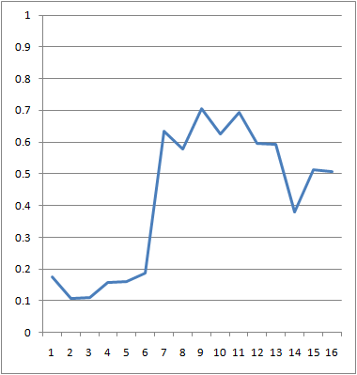
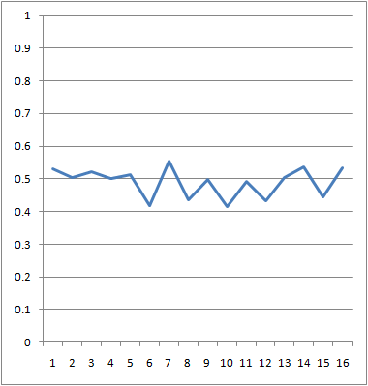
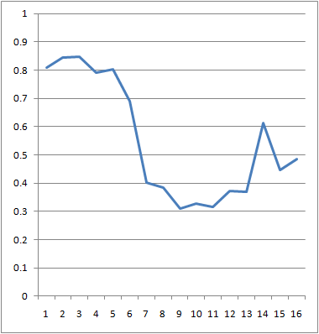
Temporal Patterns of Gene Regulation
up regulation
unchanged
down regulation

Slide 37
Data interpretation
In addition to smoothing, plotting the z_{H} values (nodes of the small hidden network) for all 21,509 genes shows clusters of expression profiles.

Slide 38
